Slide 1

CryptoCompare
API
Twitter
API
Google Trends API
CASSANDRA
Google
Geocoding
API
NEWS
API

Slide 2

Our Findings
24/7 Markets

Slide 3
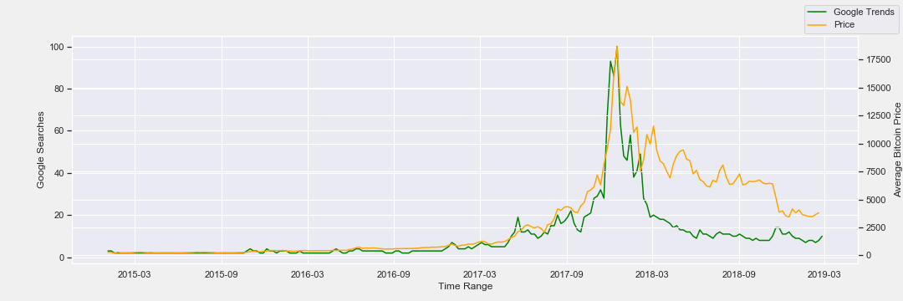

Slide 4


Slide 6

Easy To Use
Beautifully
Designed
Let Users Have Knowledge Like A Pro Without Being A Pro
THE SYSTEM

Slide 7

Random
Forest

